Slide 1

TAXI APP
Analysis & Requirements

Slide 2


Slide 3
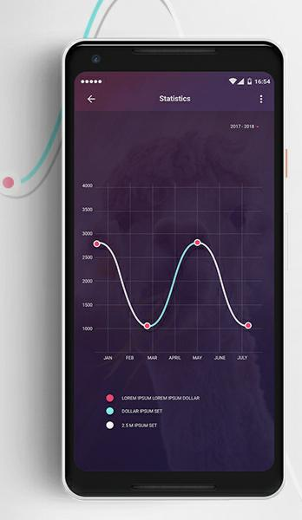
ANALYSIS
To build a software that helps taxi drivers locate passengers, the following analysis can be made: 1. Market Research: Conducting market research to identify the demand for such a software, the competition in the market, and the target audience. 2. User Needs Analysis: Identifying the needs and pain points of both the driver and the passenger to develop features that cater to their requirements. 3. Technical Feasibility: Analyzing the technical feasibility of integrating GPS, real-time updates, secure payment gateway, and other features into the software. 4. Design and Development: Designing and developing the software with a user-friendly interface, notification system, analytics capabilities, localization support, and data privacy compliance.

Slide 4
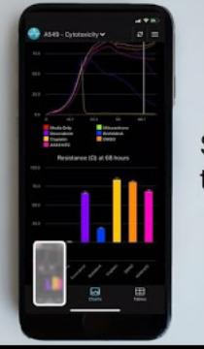
5. Testing and Quality Assurance: Testing the software to ensure it functions smoothly, is free from bugs, and meets quality standards. 6. Launch and Deployment: Launching the software in the market and deploying it on various devices and operating systems. 7. Maintenance and Upgrades: Providing regular maintenance and upgrades to ensure the software remains up-to-date and relevant to user needs.

Slide 5


Slide 6

REQUIREMENTS
FUNCTIONAL REQUIREMENTS
NON FUNCTIONAL REQUIREMENTS

Slide 7
FUNTIONAL REQUIREMENTS
1. GPS Integration: The software should be able to integrate with the GPS system to provide real-time location updates of both the driver and the passenger. 2. User Registration: The software should allow users to register and create profiles, including their contact information and payment details. 3. Booking System: The software should provide a booking system that allows passengers to request a ride, and drivers to accept or decline the request. 4. Notification System: The software should have a notification system that sends alerts to both the driver and the passenger about the booking status, location, and estimated time of arrival.

Slide 8
5. Payment Gateway: The software should have a secure payment gateway that allows passengers to pay for their ride through various modes of payment. 6. Analytics Capabilities: The software should have analytics capabilities that allow administrators to track user behavior, booking patterns, and other metrics. 7. Localization Support: The software should support localization features such as language translation, currency conversion, and cultural norms. 8. Data Privacy Compliance: The software should comply with data privacy regulations such as GDPR and CCPA to ensure user data is protected. 9. Customer Support: The software should have a customer support system that allows users to report issues, provide feedback, and seek assistance.

Slide 9

NON FUNCTIONAL REQUIREMENTS
1. Performance: The software should have fast response times and be able to handle a large number of users and requests simultaneously. 2. Security: The software should have robust security measures in place to protect user data and prevent unauthorized access. 3. Reliability: The software should be reliable and available 24/7 to ensure passengers can always find a ride when they need it. 4. Scalability: The software should be scalable to accommodate future growth and increasing demand.

Slide 10
5. Usability: The software should be easy to use for both drivers and passengers, with intuitive interfaces and clear instructions. 6. Compatibility: The software should be compatible with different devices, operating systems, and browsers to ensure a seamless user experience. 7. Accessibility: The software should be accessible to users with disabilities, with features such as screen readers and keyboard shortcuts. 8. Maintainability: The software should be easy to maintain and update, with clear documentation and well-structured code. 9. Cost-effectiveness: The software should be cost-effective to develop, deploy, and maintain, with efficient use of resources and minimal overheads.

Slide 11


